Slide 1
Using Bayesian Optimization in Pose Graphs Based SLAM 19th May
Zuxun Wang

Slide 2
Progress Since Last Meeting
Read through two papers
Weak in the NEES?: Auto-tuning Kalman Filters with Bayesian Optimization
Proposition 3 and 4 in Reliable Graphs for SLAM
Workshop code for starting point
Fill in the Project Plan form.

Slide 3
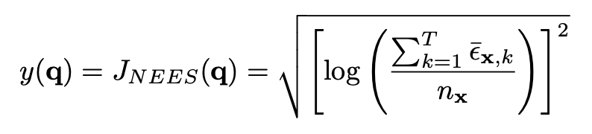
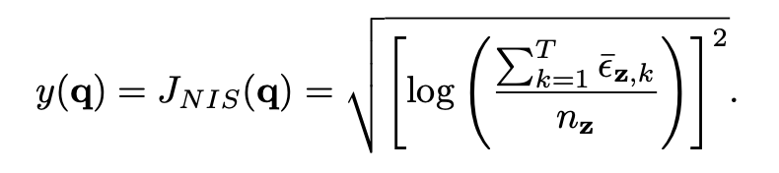
Auto-tuning Kalman Filters with Bayesian Optimization
The general idea behind tuning is to search over the space of filter parameters and assess performance.
If we can access to ground truth -> we assess performance based on the normalized estimation error squared (NEES)
If only observation sequences are available, we use the normalized innovation squared (NIS).

Slide 4
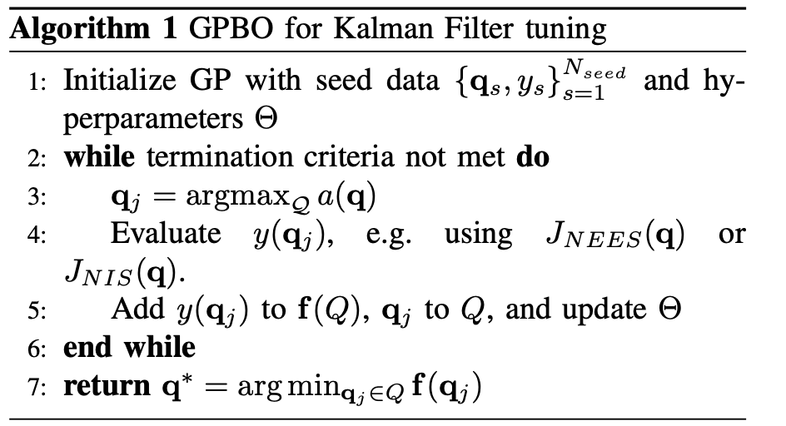
GPBO procedure for Kalman filter tuning Overview

Slide 5
Interesting Study Areas
Other cost functions, acquisition functions, kernels, parameterization
Leverage ”pre-whitening” filters to speed up convergence of GPBO
Other optimization methods besides DIRECT
GPBO will be evaluated against alternative auto-tuning approaches,
E.g., maximum likelihood estimation using expectation maximization;
online adaptive noise covariance estimation;
reinforcement learning;
and simplex-based optimization.

Slide 6
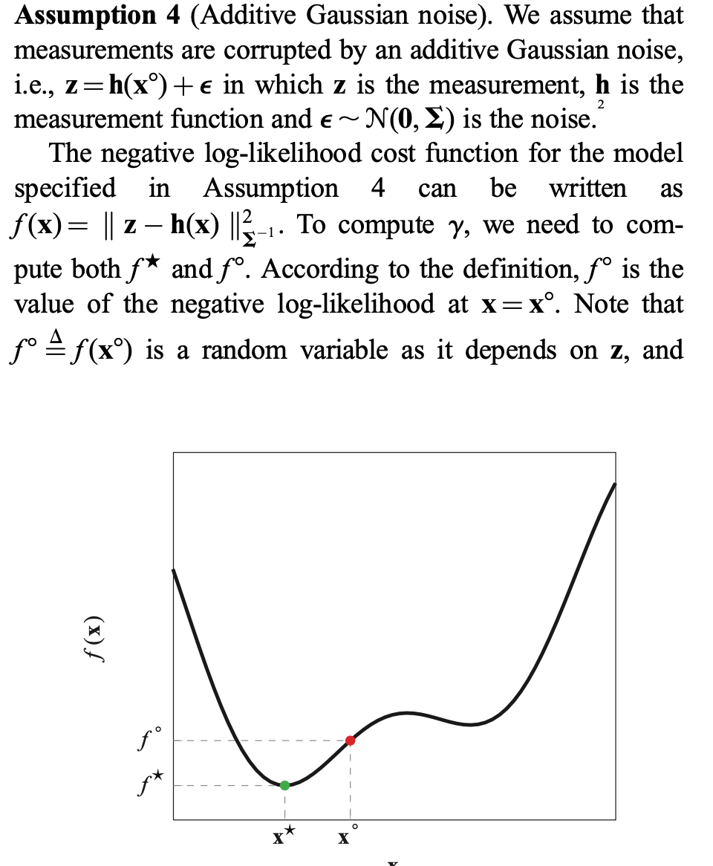
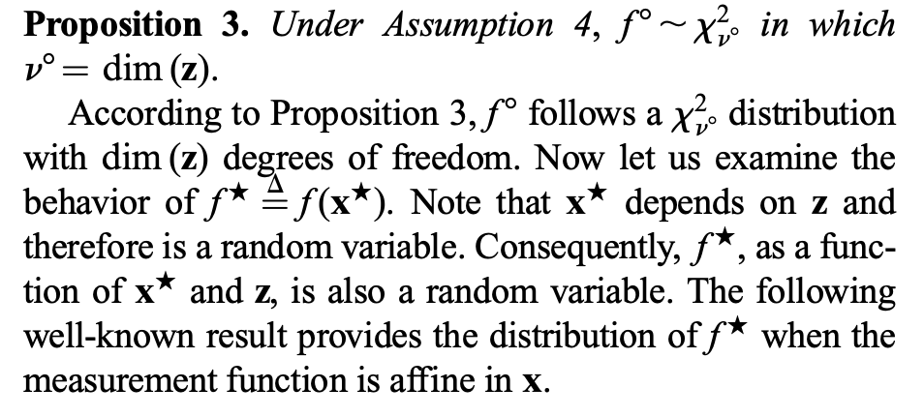
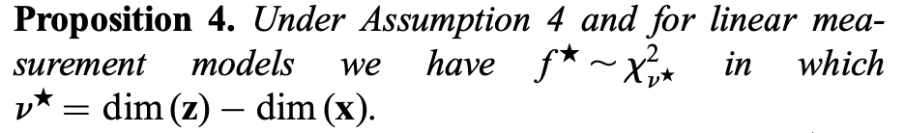

Slide 7
Problems / Issues
BayeOpt Library
Is it useful for my project?
Source code for used example. (Section IV) in "Weak in the NEES?: Auto-tuning Kalman Filters with Bayesian Optimization.”
Fix process model?

Slide 8
Planned Activities
Try with 1D/2D process model with MATLAB
1D Beam
2D Vehicle
Explore using example code for workshop topic2-part2
Might work with Bruce to test with ground truth case
Test without ground truth
Guest talk next Friday (26th May)?
Referring to Simon’s paper (in-progress paper) for inspiration?

